Slide 1
Improving CDM Measurements
With Frequency Domain Specifications
Jon Barth, John Richner, Leo G Henry
Barth Electronics, Inc.
Notes:
Because most in this audience are “Device Guys” this presentation will be mostly metrology data to explain how these measurements developed and directed this work.
Therefore the sequence of this presentation is somewhat different than the printed version and you may find it difficult to follow along in the printed version.
The CDM test was developed many years ago with materials common and familiar to the semiconductor industry.
The CDM verification methods used today needed improvements in repeatability.
Improved measurement accuracy will improve repeatability as a result.
The original CDM test was intended to simulate the CDM threat with acceptable repeatability between testers.

Slide 2
Objectives
The goal for this work began 20 years ago:
Improve CDM Measurement Accuracy
Investigate Existing Components in daily use
Design of new measurement components
Evaluate their repeatability at multiple sites
Change CDM standards to improve specs
Notes:
The original CDM test provided reasonably consistent testing between different testers in the same standard.
We began investigating the measurement components in the CDM tester 20 years ago.
It was a long process of analyzing the verification modules and current sensors as to what caused the variations.
Our acquisition of a RCDM3 tester allowed us to began the design of improved measurement components.

Slide 3
Outline
Introduction
Background of existing Measurement Techniques
Develop new Measurement Techniques
Measurement Data
Spice Analysis
Conclusions
Notes:
The sections in this presentation:
-Introduction explains CDM repeatability problems and the CDM verification method.
-Background shows the original Disk resistor, the 50 ohm adapter, and 5 of the original pulse waveforms.
-Measurement Techniques will introduce the 4 CDM elements in the measurement chain.
It explains the present technique of specifying the complete measurement chain by identifying the discharge waveform
It explains the improvements possible with individual specifications for the individual measurement components.
Measurement Data shows the multiple capacitors used to identify the CDM frequency range, and measured frequency and pulse responses of existing sensors.
It describes how the “Tuning” Cavity Issues affect the measured waveforms.
-Spice analysis shows how we identified circuit elements with discharges using known capacitor values.
-Future work (Conclusions)

Slide 4
INTRODUCTION
Existing CDM measurements do not correlate between testers
New wide bandwidth scopes further complicated the problem.
Time domain characterization of the test output does not provide the necessary information to improve the test.
Frequency domain characterization of the measurement components would be better!
Notes:
I probably do not have to repeat the lack of correlation between different testers
But jumping directly to new wide bandwidth scopes displayed the current sensor measurement errors but did not identify their cause or effect.
The original CDM waveform measured in the time domain made everyone think in terms of time domain measurement parameters.
However, test data with the new current sensor and VM produced the realization that the measurement chain operated in the frequency domain
This led to identifying each CDM measurement component needed in the frequency domain.

Slide 5
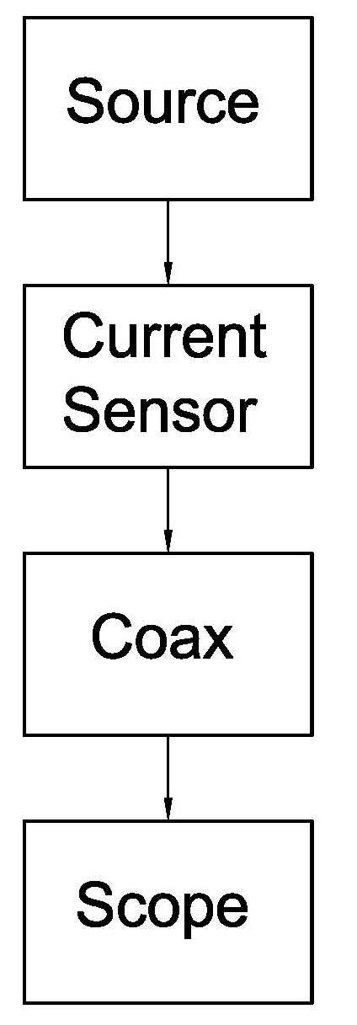
Background
The existing verification method
consists of combining All CDM
components in the Measurement
Chain to measure discharge
waveform with a scope
This verification method ignored
their individual and variable
measurement characteristics
Notes:
The CDM generation and measurement chain has four separate elements, each of which affects the discharge waveform in small or large ways.
The original and existing verification method combined all the elements in the CDM measurement chain into one time domain measurement using 1 GHz bandwidth scope.
This provided some reasonable repeatability in the beginning,
However how each component affected the measurement accuracy and was either not understood or was ignored.
This method would have worked fairly well if each component in each system had the same response, and each met its individual specification. (DELETE)
Wider bandwidth scopes added another set of specifications when we combined the different ESDA and JEDEC current sensors one standard. (JS002) (DELETE)

Slide 6
Background
The verification module dielectric has been FR4, which when used for a precision Capacitor, has stability/variability issues
Other dielectrics were proposed in our 1999 analysis, but were never implemented.
“Tuned” Cavities in front of current sensing resistor were added to correct low response with 1 GHz scope
Notes:
We first identified FR4 as a poor dielectric for standard capacitors.
There were a lot of high frequency details in CDM testing that needed to be recognized to improve repeatability.
The alumina dielectric suggested as a simple change was never implemented by manufacturers of CDM testers.
A major change occurred when the original high frequency disk resistor was no longer available.
And it was replaced with a ring of ordinary chip resistors; but the frequency response of the new resistor design was not measured to identify its suitability as a replacement.
Its response was identified with a 1 GHz bandwidth scope.
The new time domain response of the JEDEC current sensors did not make the peak current requirement so ‘tuned cavities were inserted in front of the one ohm current sensing resistor.
While that “fix” brought the response up with a 1 GHz scope, its real response was severe ringing distortion.
In addition, the high impedance of the resonant cavity obviously changed the discharge current waveform and affected the DUT failure level in some manner.

Slide 7
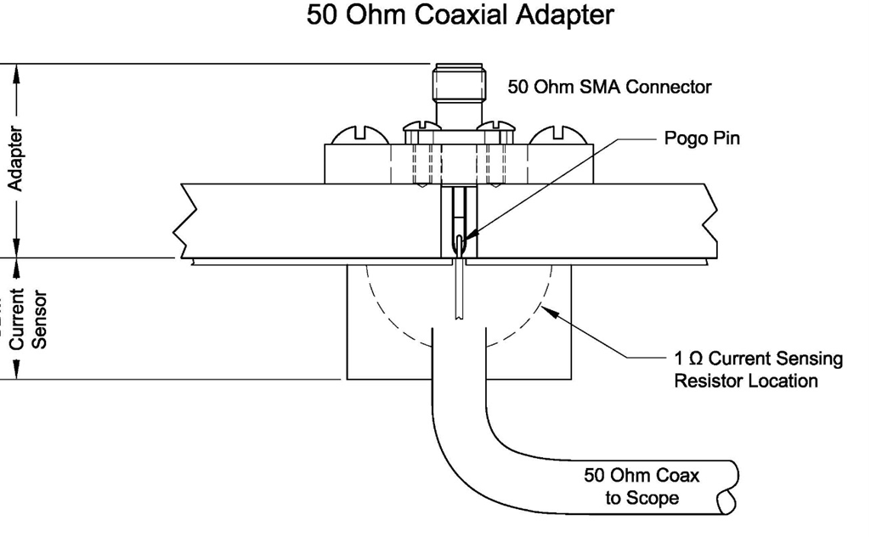
Background
In 1996 We made a 50 ohm coaxial adapter
Connected to the current sensor, it measured the pulse response
50 Ohm Coaxial Adaptor
50 Ohm SMA Connector
Adapter
Pogo Pin
Current
Sensor
1 Ohm Current Sensing
Resistor Location
50 Ohm Coax to Scope
Notes:
Early on as a “measurement guy” I wanted to know the response of the CDM current sensors.
I made the 50 ohm coaxial adapter shown here and measured some of the existing current sensors.
The data was published in 1996; but alas, nothing was done about the measured variations shown next.

Slide 8
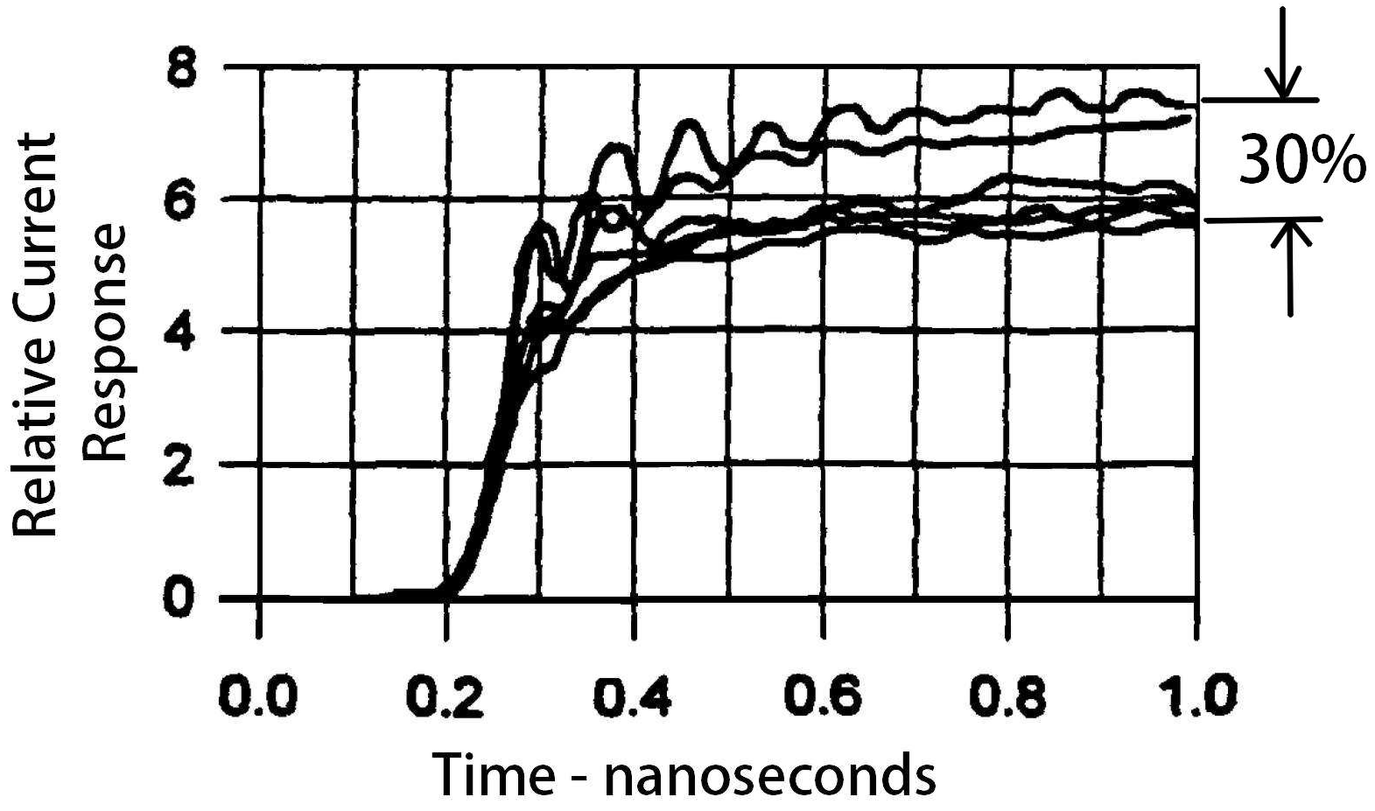
Background
Pulse response of 6 current sensors
Notes:
The responses of these current sensors at about 0.5 to 1 ns where the peak of the CDM discharge typically occurs had a total variation of 30%.
These variations in sensitivity were produced using similar one ohm disk resistors.
However CDM system manufacturers did nothing to improve their response,
These tests for current sensor uniformity could have been done at any time; but our complaint to the manufacturers were never addressed.
This is when I began to complain at every CDM meeting about the variations in measurement sensitivity.
8/4/2016

Slide 9
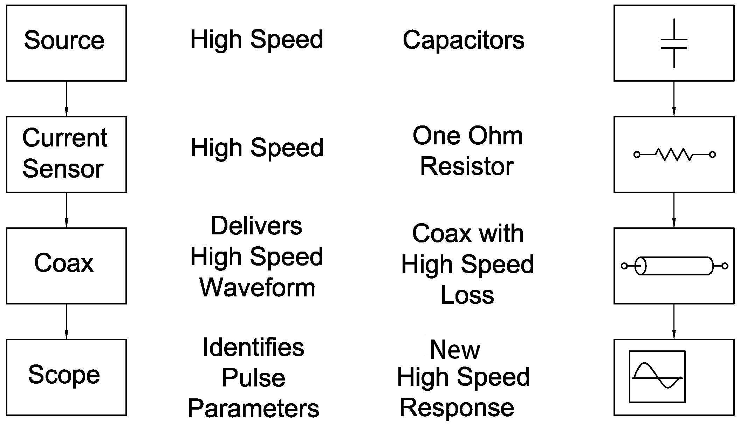
Measurement Techniques
CDM Measurement Chain
Notes:
These are the four elements in the CDM measurement chain
The source is either a device being tested or a verification module used to verify that the tester is operating within spec .
It is charged to a specific voltage and discharged which produces the CDM waveform and DUT threat .
The current sensor is a one ohm resistor than converts the discharge current passing through it into a voltage to be measured.
The voltage is then carried by short coaxial cable to the Scope
The scope displays and measures the waveform parameters which provide time domain waveform parameter data.

Slide 10
Measurement Techniques
Verification module
Dielectric constant of FR4
Dielectric Constant – FR4
5.5
5.0
Permittivity (DK)
85/85 saturated
4.5
At 25°C
4.0
1
10
100
1000
10000
Frequency (MHz)
Notes:
This is the dielectric constant of the CDM homemade verification module capacitors.
Not only is the dielectric constant variable with frequency; but the dielectric loss factor is high at 1 GHz and above it is not typically specified.
Its differences between wet and dry adds to the frequency response of the disk resistor used for the original CDM current sensors.
Note that this limited measurement data ends at about 1500 MHz, because it is typically not used for more than a few cm trace lengths with higher frequency data signals.
FR4 is not a good dielectric to be used as a reference discharge capacitor at high frequencies! Actually, it is a lousy dielectric for any standard application.
8/4/2016

Slide 11
Measurement Techniques
Alumina Verification Module
Dielectric constant varies < 1% to 3 GHz
10
Dielectric Constant - Alumina
9
Permittivity (DK)
2%
8
7
1
10
100
1000
10000
Freq. (MHz)
500
2500
Notes:
This is the dielectric constant of 99% alumina which changes less than 1% up to 3000 MHz.
In addition, its loss factor is less than 1/100th that of FR4 at CDM discharge frequencies.
The lower loss factor at these frequencies does not absorb any of the charge so it is all delivered to the discharge.
When the exact same capacitance values for FR4 and Alumina are used as verification modules, the discharge from the alumina capacitor is 10 % higher amplitude than that from the FR4.
Let me point out that all the waveforms displayed in this presentation and the paper are discharges from verification modules.

Slide 12
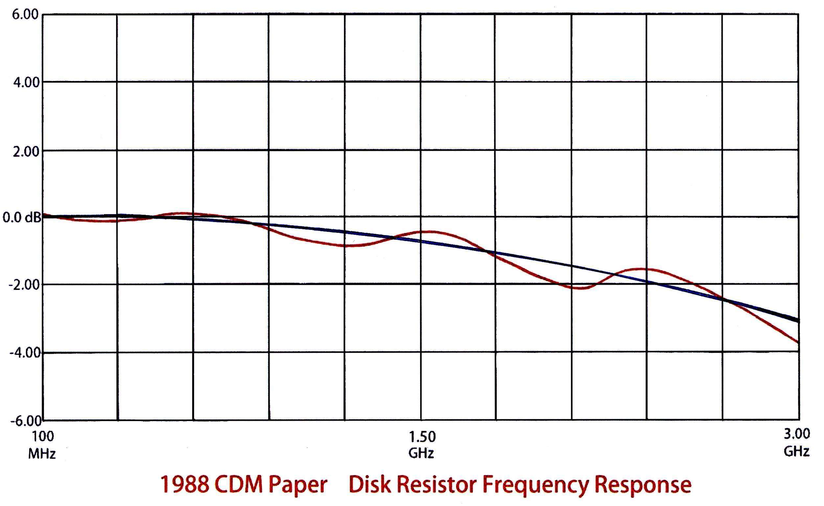
Measurement Techniques
Frequency response of original Disk Resistor
6.0
4.0
2.0
0.0 dB
-2.0
-4.0
-6.0
100
MHz
1.50
GHz
3.00
GHz
1988 CDM Paper: Disk Resistor Frequency Response
Notes:
This is the frequency response of the disk resistor used for the original CDM current sensors.
The red response is taken directly from the original 1988 paper.
I physically transferred the original response at this amplitude and time scale, so all current sensors can be viewed with the same parameters.
The nominal attenuation is 28.3 dB which is used as a zero reference for the 1 ohm per volt sensitivity of a one ohm current sensing resistor when measured in a 50 ohm system.
The ripple is caused by reflections when measuring one ohm impedance in a 50 ohm system.
The black line is my estimate of the frequency response if the one ohm current sensing resistor had more attenuators been used eliminate the effect of reflections.
The basic issue here is that you would expect the response measured with the specified 1 GHz scope which is down 3 dB at that point, would be fairly consistent from scope to scope and current sensor to current sensor. Somehow the individual responses shown in the previous slide were not closely repeatable.
*Note that at 2.5 GHz the response is has increased to 2 dB.
This was the last time that a current sensor was measured in the frequency domain until the newly designed unit.
0.1 dB= 1.16 % 1 dB = 12.2%

Slide 13
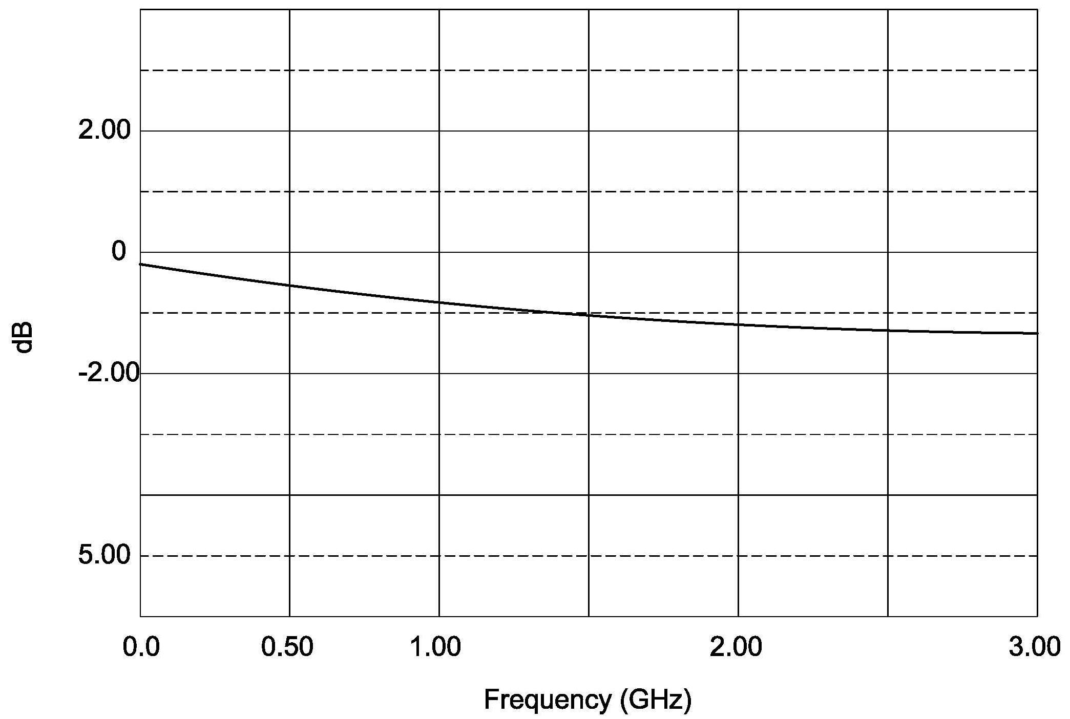
Measurement Techniques
Coaxial cable Loss with frequency
2.0
0
dB
-2.0
-5.0
0.0
0.5
1.0
2.0
3.0
Frequency (GHz)
Notes:
The Sucoflex 104 coaxial cable that is supplied with the RCDM3 tester has a low but definite loss at CDM discharge frequencies.
This loss with frequency is fairly uniform among these cables and its variations with frequency can be ignored for the present.
It is shown to be complete in analyzing the frequency response of each measurement component.
0.1 dB= 1.16 % 1 dB = 12.2%

Slide 14
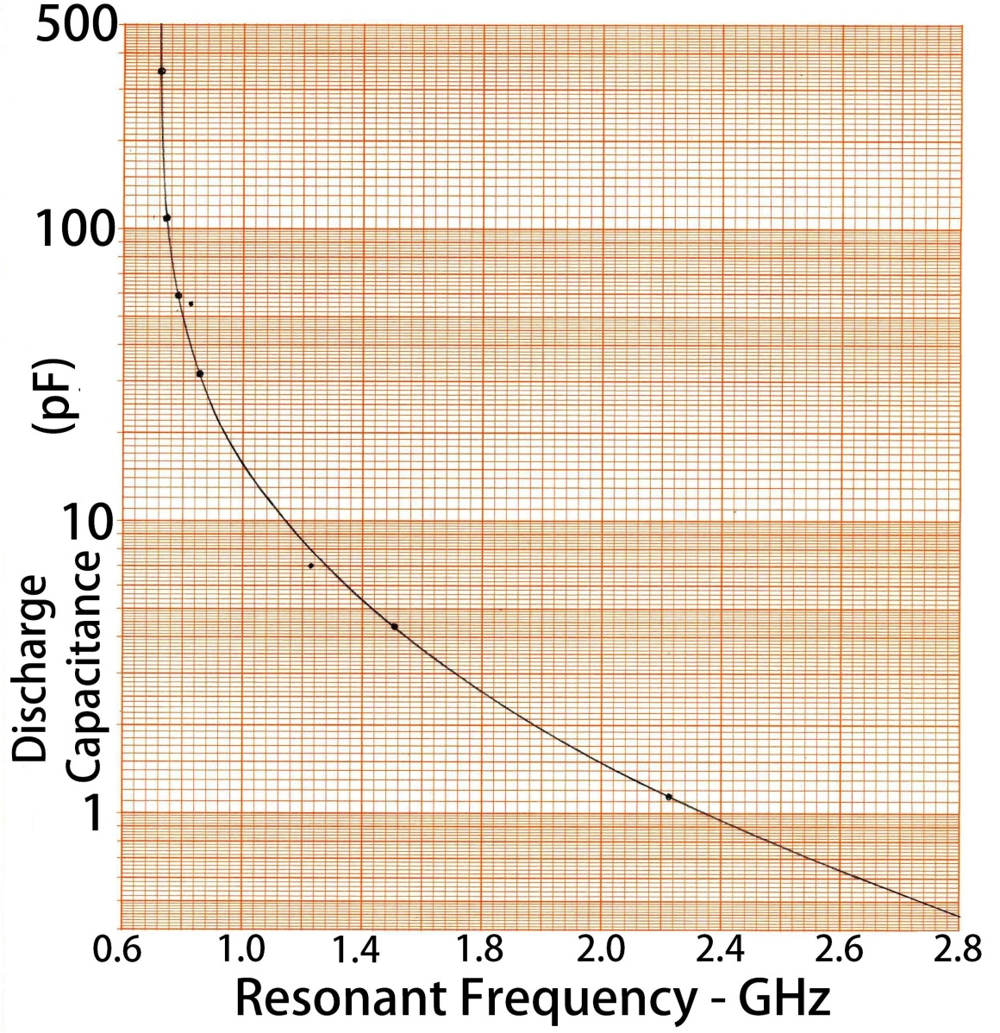
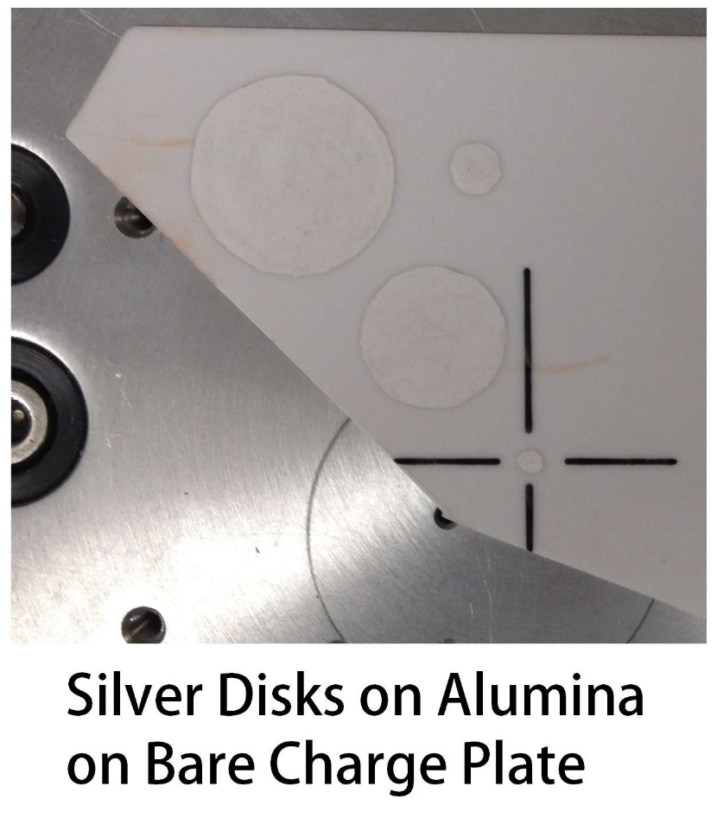
Measurement Data
Discharge frequencies of alumina capacitors
Notes:
Using our resistor manufacturing technology, we fired silver electrodes on both sides of ten mil alumina to make a series of HF capacitor to measure their discharge waveforms.
The photo on the right show the spare piece of 10 mil alumina with four silver top capacitor electrodes on it.
It is sitting on the bare RCDM3 charge plate (We removed the FR4 insulator)
We put alignment marks on the smallest capacitor disk to assist in lining it up with the pogo pin for the discharge.
We measured them with the new uniform response current sensor to identify the resonant frequencies produced by each capacitor.
This plot identifies the frequency range expected for each discharge capacitor value.
The high frequency end at 2500 MHz occurs with about 1 pF of capacitance and the low frequency end of about 600 MHz is determined by the 330 pf capacitor value.

Slide 15
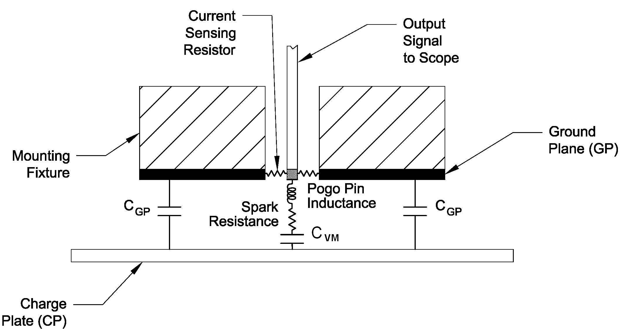
Measurement Data
The CDM tester is a resonant Circuit formed by the Pogo Pin inductance and DUT Capacitance
Current
Sensing
Resistor
Output Signal
to Scope
Ground
Plane (GP)
Mounting
Fixture
C_{GP}
C_{GP}
C_{VM}
Charge
Plane (GP)
Spark
Resistance
Pogo Pin
Inductance
Notes:
The CDM circuit includes spark resistance damping of the sine wave and the one ohm current sensing resistor; as well as high frequency losses in each component.
They produce a highly damped discharge waveform anyone doing CDM testis is familiar with.
Be aware that all the waveforms displayed in this presentation and the paper are discharges from alumina verification modules.

Slide 16
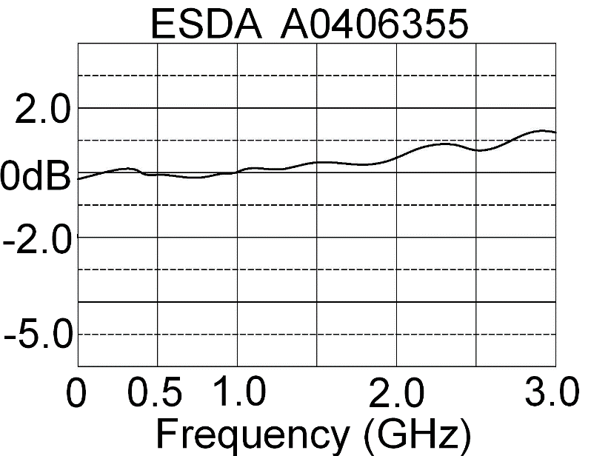
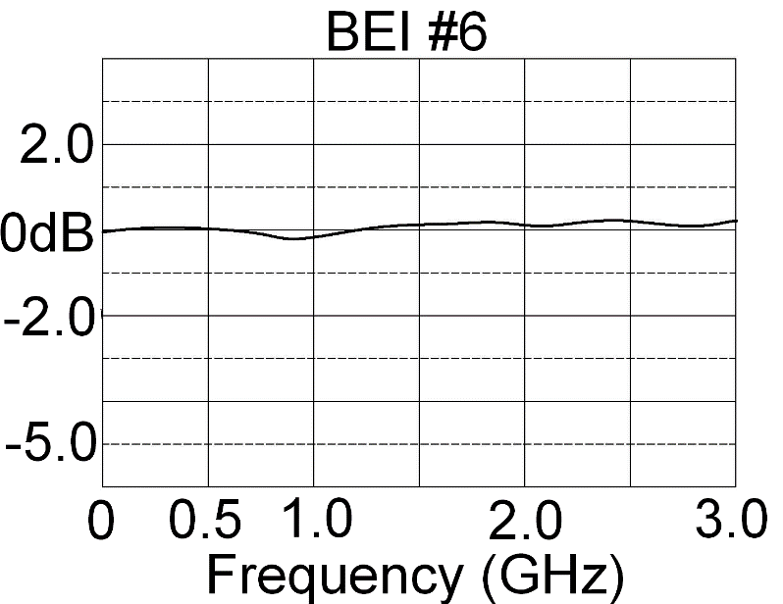
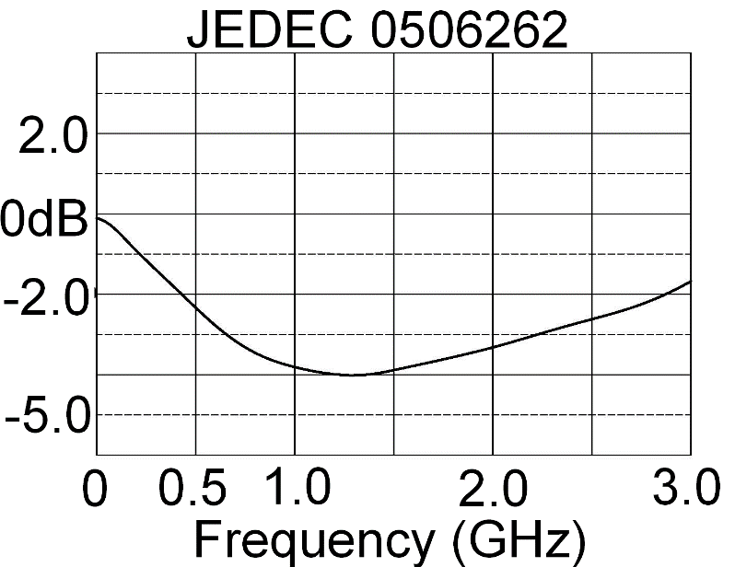
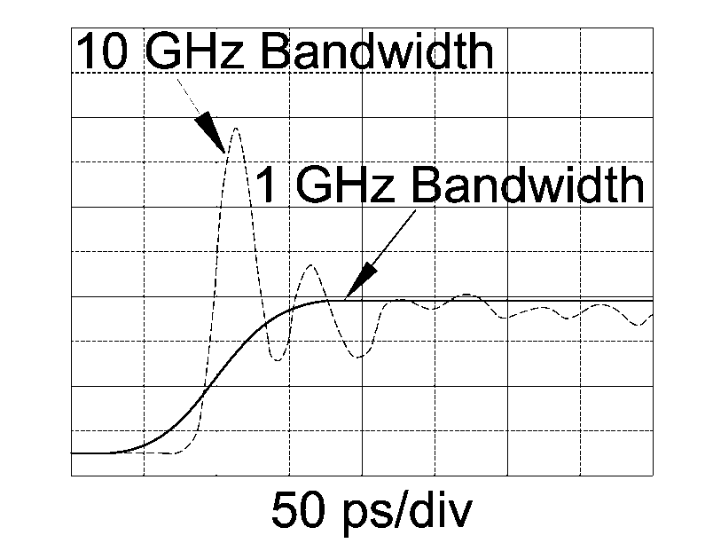
Measurement Data
Frequency response of existing current sensors
Notes:
Anthe left side are the frequency response of some CDM current sensors from operating systems. Some are relatively flat. Some have major variations if frequency response.
There was no average response of the six different current sensors measured.
The two plots on the left illustrate the tremendous variation in CDM current sensors in daily operation.
The top one is fairly reasonable to about 2 GHz while the one below has 4 dB decreased response (0.63 amplitude) between 1 and 1.5 GHz.
The top right plot shows the frequency response of the new current sensor design with about .15 dB variation (0.98 amplitude response) to 3 GHz.
The two bottom plots of the same current sensor shows its frequency response on the left and its time domain response on the right.
The ringing response on the right I identify as “tuning”. It was added to some current sensors when its discharge amplitude response did not meet the required spec when measured with a 1 GHz scope.
The next slide shows the CDM discharge waveform when this type current sensor is used in verification.

Slide 17
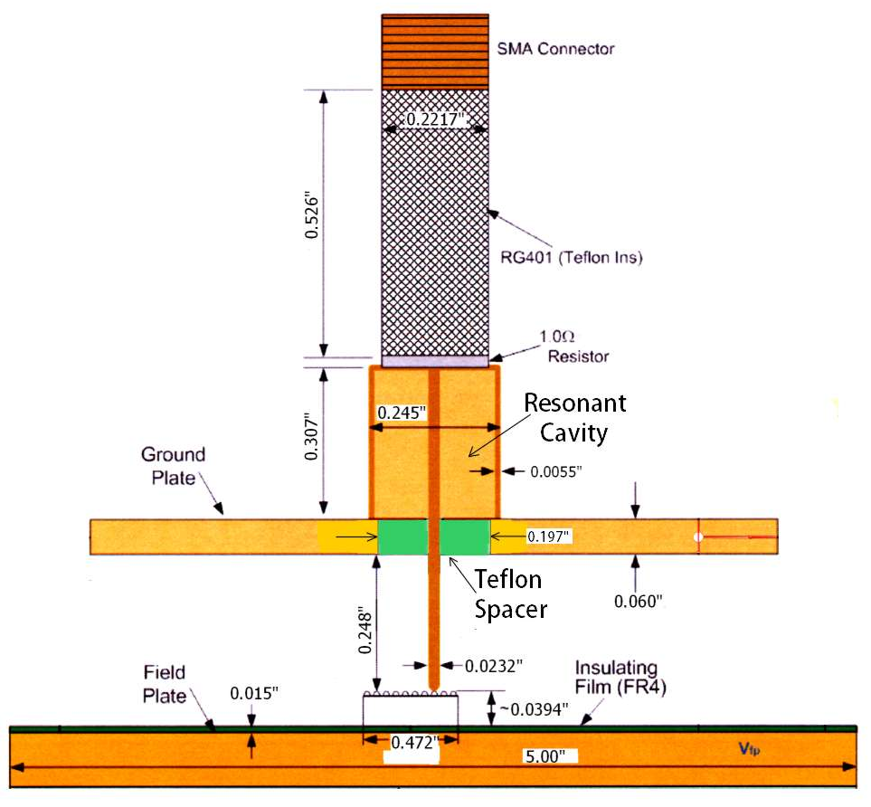
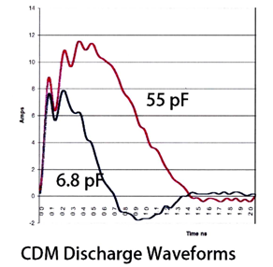
Measurement Data
“Tuned” Cavities in front of current sensing resistor
Added to correct low response with 1 GHz scope
SMA Connector
12
1 ohm
Resistor
8
Amps
Ground
Plane
Resonant
Cavity
4
Insulating Film
(FR4)
Teflon Spacer
0
-2
0
1
2
Time ns
CDM Discharge Waveforms
Field Plate
Notes:
This is a diagram of how the cavity is placed in front of the current sensing resistor to improve the 1 GHz scope response.
It causes two different problems.
1. It adds ringing to the discharge, distorting what the response would be without the resonant cavity which confuses the true discharge waveform.
The discharge waveforms taken with a “tuned” current sensor and a scope with > 1 GHz bandwidth show the ringing current from the verification module.
2. The cavity’s high impedance is a severe distortion of the intended one ohm impedance used to have only a minor effect on the discharge current.
Does this distorted impedance change the device failure, making it fail at a lower or higher voltage level?
In addition it produces an extremely fast risetime that is a distortion of the discharge measured with a true one ohm current sensing resistor.

Slide 18
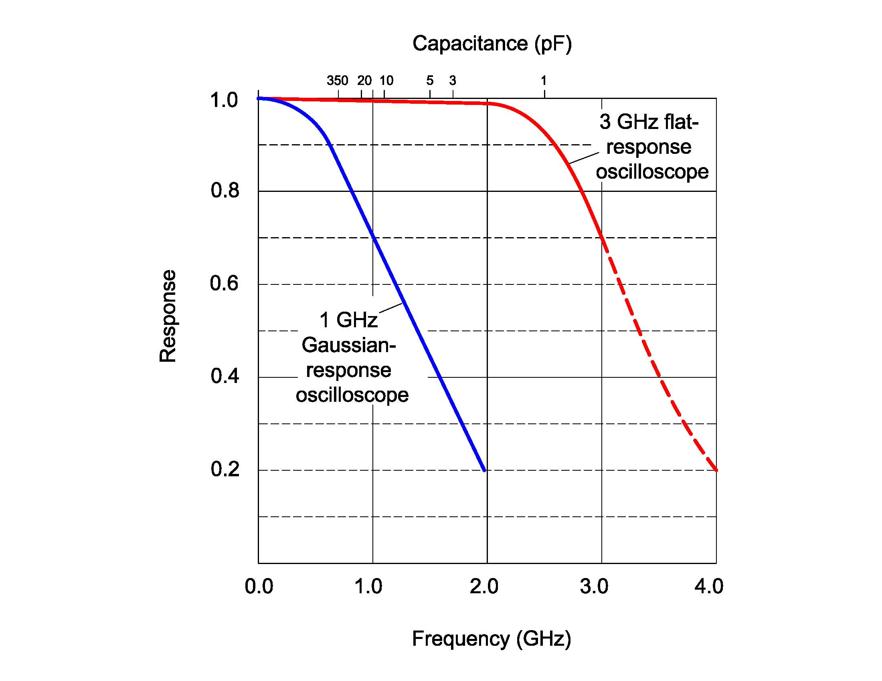
Scope Response
CDM Discharge Measurement Accuracy
Capacitance (pF)
350 20 10 5 3 1
1.0
3 GHz flat response
oscilloscope
0.8
0.6
Response
1 GHz
Gaussian
response
oscilloscope
Response
0.4
0.2
0.0
1.0
2.0
3.0
4.0
Frequency (GHz)
Notes:
On the Keysight scope web-sight, which is their most recent name, that was previously Agilent and before that HP, states:
“Most scopes with bandwidth specifications of 1 GHz and below typically have Gaussian–type response, and most scopes with bandwidths greater than 1 GHz typically have a maximally-flat type response.”
The use of higher bandwidth scopes with flat response will be an improvement over Gaussian response scopes. Our estimation for a 3 GHz scope will have a very uniform frequency response to 2 GHz.
The top scale identifies DUT capacitance lined up with the frequency it will create at the bottom Frequency (GHz) notification.
The response of a flat response oscilloscope will be down only about 8% at 2.5 GHz where very small devices of 1 pF capacitance, resonate in the CDM test.
Therefore a 3 GHz maximally flat response scope should be sufficient for verification of the new components used with RCDM 3 testers.
The use of a 6 GHz scope should be sufficient for verification and any other r& de work on small devices that produce resonances at 2.5 GHz.
8 GHz bandwidth scopes are a bit of overkill with their theoretically flat response to 4 GHz.
Measuring the actual response of digital scopes remains to be done, to validate this general scope data.
We can see how poorly CDM measurement accuracy has been when measured with 1 GHz Gaussian roll-off scopes with.

Slide 19
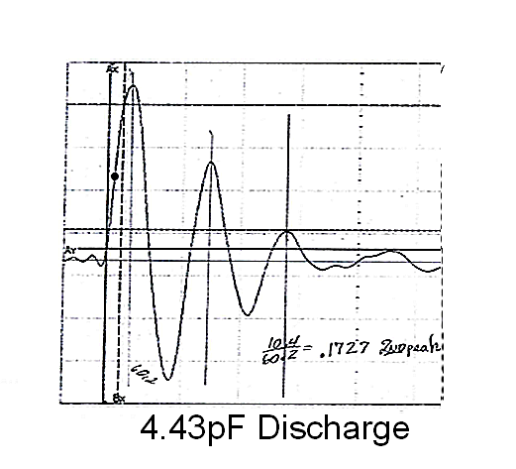
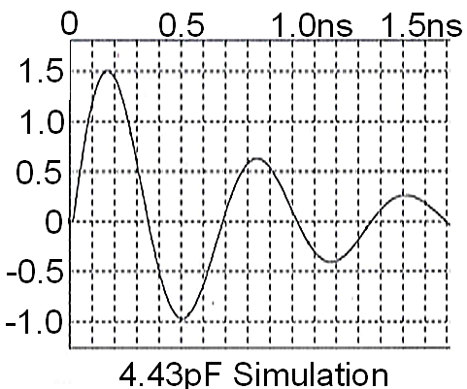
Spice Analysis
Discharges with uniform response current sensor
Spice values selected to simulate real discharges
Done for multiple capacitance value created table
Notes:
We made a series of discharges for each of 7 alumina capacitors, one of the 100 volt discharge waveforms is shown on the left.
We were only interested in the damping factor; which is primarily controlled by the combined spark and current sensor resistance.
Using a current sensor where it maintains one ohm resistance at all frequencies, provides a key value in the CDM discharge circuit.
That data has been too variable to provide accurate simulations.
The Spice circuit on the right used the same capacitance value used in the discharge that produced the damped waveform on the left.
The Spice circuit inductance was adjusted to get the same resonant frequency.
The Spice series resistance was adjusted to achieve the same damping factor measured for the first and second peak amplitudes.

Slide 20
Spice Analysis
Different Capacitors produced different frequencies with different damping factors
Each had different RS1 and RS2 resistances
 | Pogo Pin Inductance Calculations
F Measured Frequency GHz | C Verification Capacitor Alumina pF | C₁₂ Series combined capacitance pF | L Pogo Pin calculated inductance nH | R_{S1} Spice Model Value for >1 cycle, Ohms | R_{S2} Spice Model Value for Normal CDM Ohms
2.420 | 1.15 | 1.049 | 4.101 | 10 | 38
1.500 | 4.43 | 3.236 | 3.456 | 7 | 19
1.310 | 6.80 | 4.340 | 3.370 | 7 | ?
0.856 | 31.80 | 8.712 | 3.967 | 3.85 | 16.2
0.783 | 58.30 | 9.952 | 4.152 | 3.60 | 16.0
0.753 | 109.00 | 10.810 | 4.133 | 3.64 | 14.0
0.724 | 343.00 | 11.594 | 4.168 | 3.22 | 14.0
Notes:
This simple three element CDM simulation demonstrates how a new current sensor and verification module combined with accurate frequency response of the scope and coaxial cable can provide improved data for CDM designers.
There are many additional smaller LRC elements that can be added to make the simulation more precise; but inaccurate measurements made until now produced simulations that may have pointed designers in wrong directions.
These were simple measurements that have not had parasitic elements that occur at high frequencies considered.
The inductance of the pogo pin should probably include some time delay effects in the current traveling through the verification module capacitors and possibly even the ground plane.

Slide 21
Conclusions
The frequency response of all 4 individual elements in the CDM measurement chain must be identified.
Calibrated, HF capacitors and uniform frequency response current sensor are needed to improve CDM
Need Methods to identify scope frequency response
The coax loss is minor but should be considered
The basic goal was to improve CDM measurements
Accurate component values assists CDM simulation
Notes:
The frequency response of each element is the CDM measurement chain needs to be specified, and we have shown the basic measurement process.
They have to be measured in the frequency domain to provide accurate waveform parameters in the time domain.
A new current sensor and verification module can replace the old units with poor frequency response
Remember that spark resistance variations still cause variations in peak current.
Our basic effort for these many years has been to improve the accuracy of CDM measurements.
More Accurate Spice elements can improve analysis and investigate other parameters in the CDM test.

Slide 22
Location: C:\1DATA\ESD\CDM\Papers\2016 ESDA\Paper\Power Point\Versions\Version 10.pptx

